Slide 1


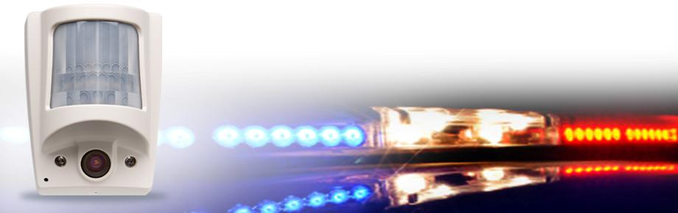
Videofied
Product Overview:

Slide 2

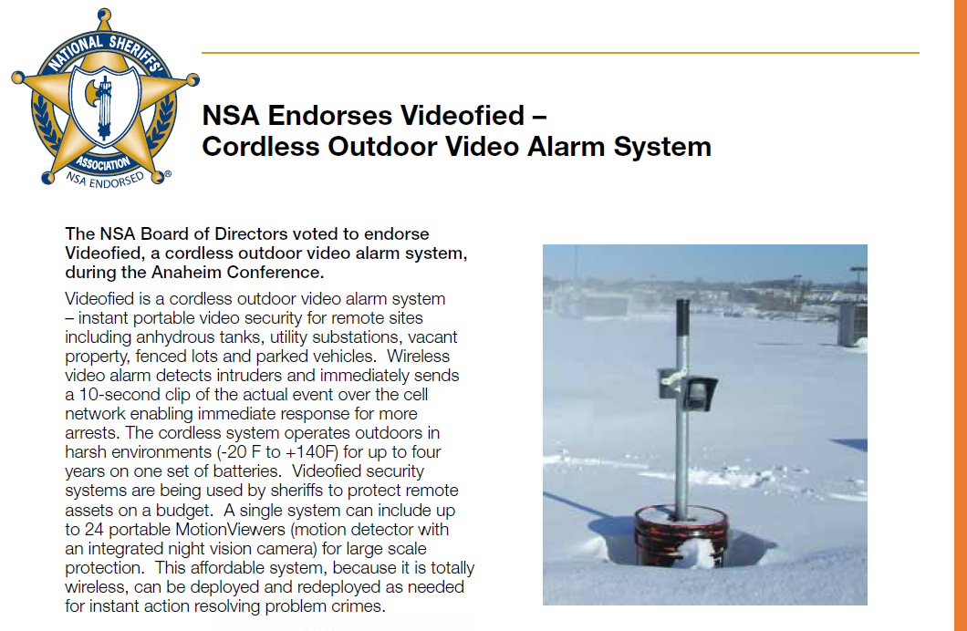
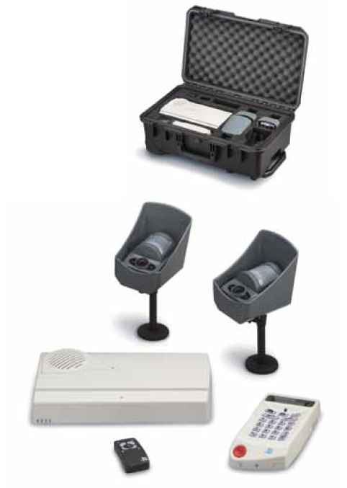
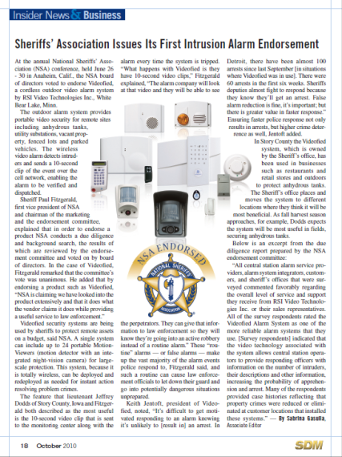
Sheriffs Endorse
Videofied

Slide 3
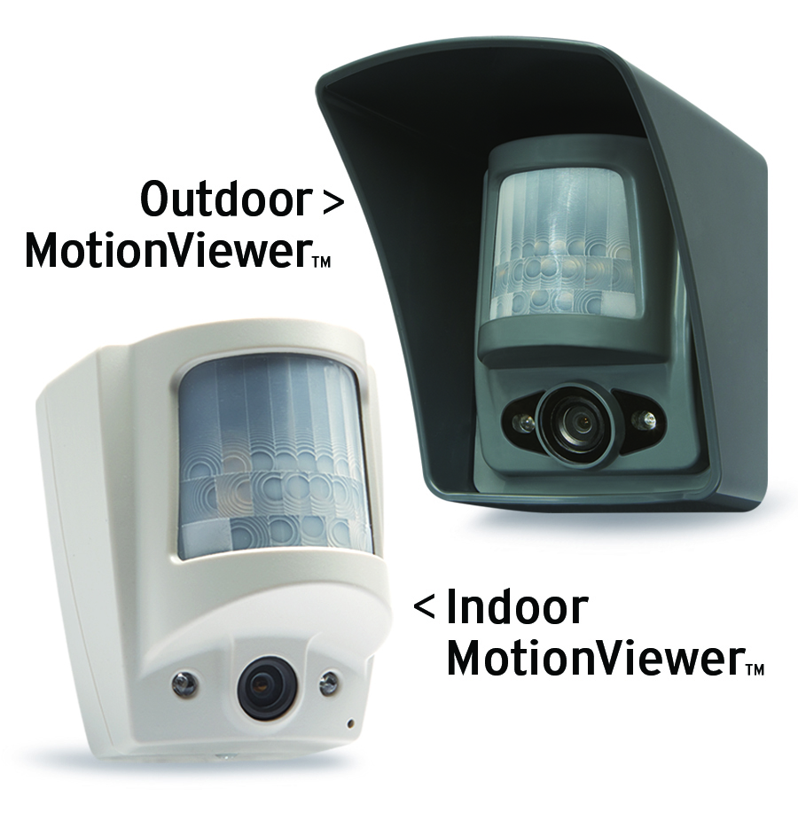
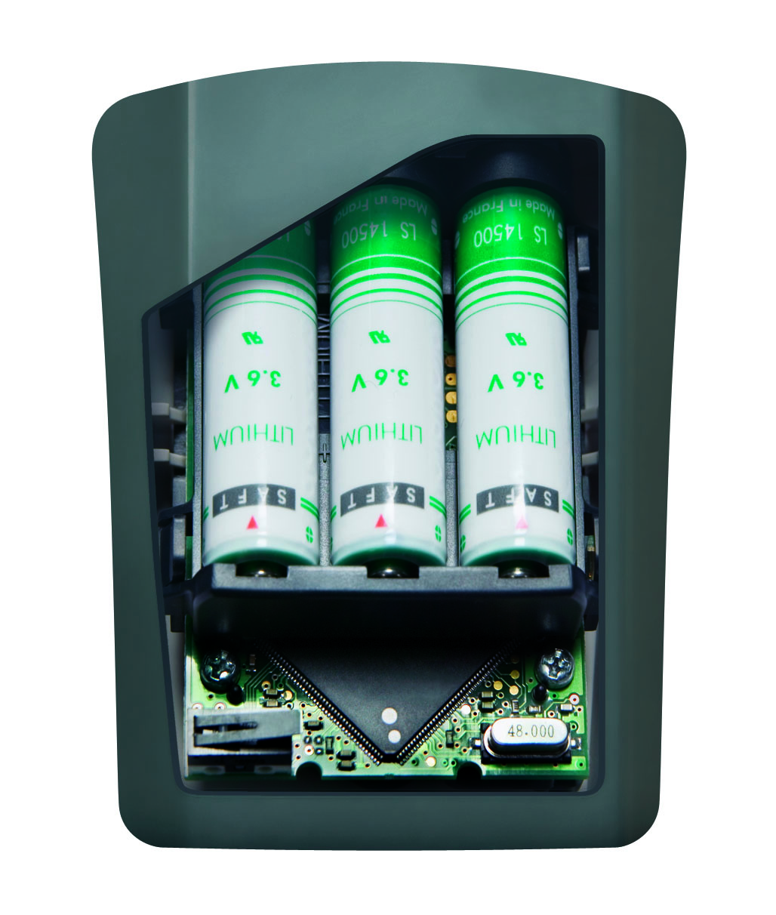
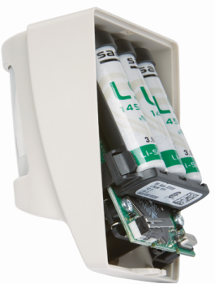
How does it work?
Bi-Directional Radio Transceiver to Panel – 900 MHZ
  PIR Motion
  Sensor
Cordless
No AC connection
Up to 4 Year Life
Infrared
Illuminators
  Night Vision
  Digital Camera

Slide 4


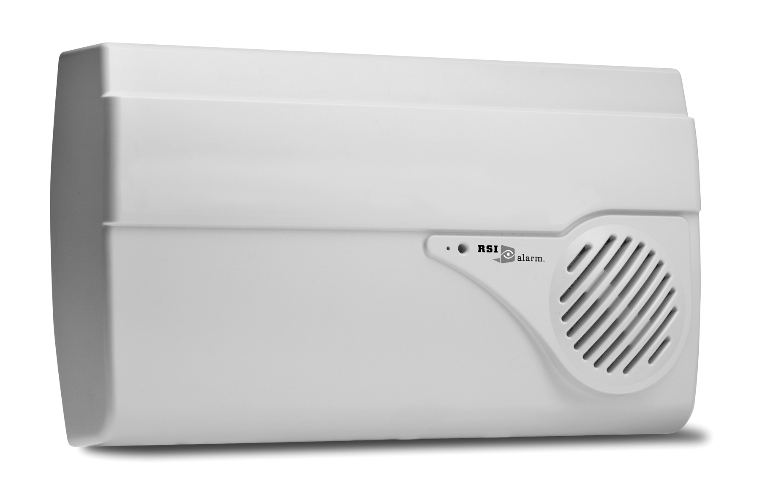

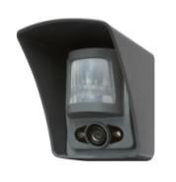
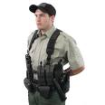
Immediate Detect
Priority Response
Cell Tower
Panel
Hub
900 MHz
Monitoring
Station
MotionViewer
Responder

Slide 5
Applications
Special
Applications
Surveillance
Blended Video to enhance surveillance
Commercial Outdoor
  Fenced Lots
  Utilities
Portable/Temporary
  Construction
  Municipal
Mainstream
Cell Upgrade with Video Included
Small Commercial
Residential

Slide 6
Applications
Special
Applications
Surveillance
Blended Video to enhance surveillance
Commercial Outdoor
  Fenced Lots
  Utilities
Portable/Temporary
  Construction
  Municipal
Mainstream
Cell Upgrade with Video Included
Small Commercial
Residential
Click on application for more info

Slide 7
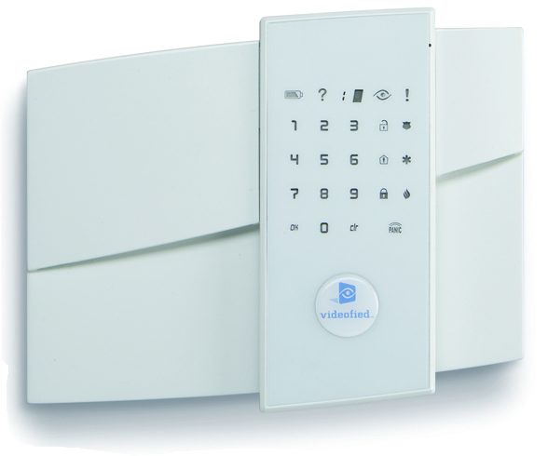

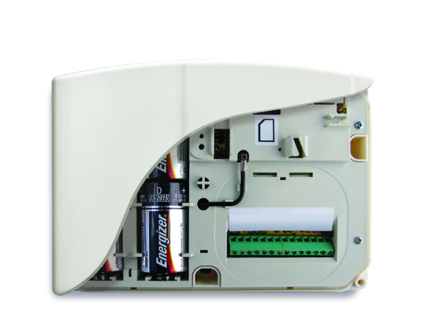
Panels
V6000 GPRS
XL
XT

Slide 8
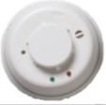
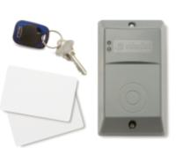
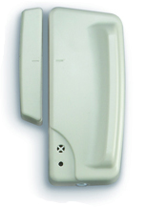

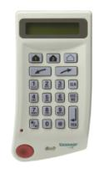
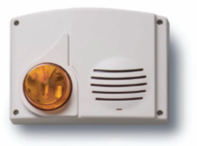
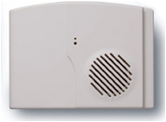
Peripherals/Accessories
Smoke
Contact
Exterior
Prox Arming
Remote
Arming
Exterior
Siren/Strobe
Interior
Siren
Keypad

Slide 9
For more information:
www.videofied.com
877-206-5800
info@videofied.com

Slide 11
Special Applications
Unique capabilities open new markets and applications
  Outdoor
  Construction
  Remote
  No Power, Phone or Internet
Demands new business model
Increased Monitoring and Cell Charges

Slide 12
Special Applications
Increased Monitoring and Cell Charge Costs
Controlled
Uncontrolled
Fenced lots
Construction sites with limited access
Vacant Property
Cell + Monitoring
No fence or barriers
Remote access points
Temporary Stakeouts
Cell + Monitoring

Slide 13
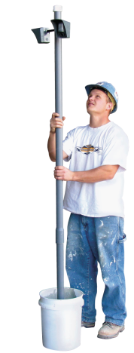
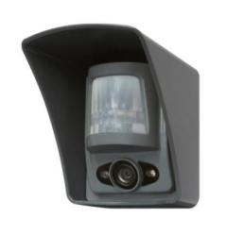


Special Application Products
Outdoor
MotionViewer
PIR
Motion
Sensor
V6000 GPRS
Panel
Video Camera
Standard
Extended Temp

Slide 14
Peripherals/Accessories
Smoke
Contact
Exterior
Prox Arming
Remote
Arming
Exterior
Siren/Strobe
Interior
Siren
Keypad

Slide 15

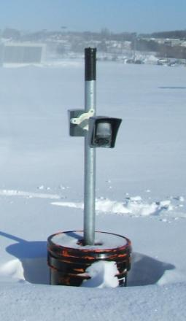
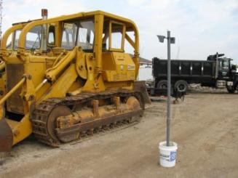
Outdoor Video Security System
Special Applications
Portable/Mobile
900 MHz
AES Encrypted
-20° F
Night Vision
All-Weather
4 Year Battery

Slide 16
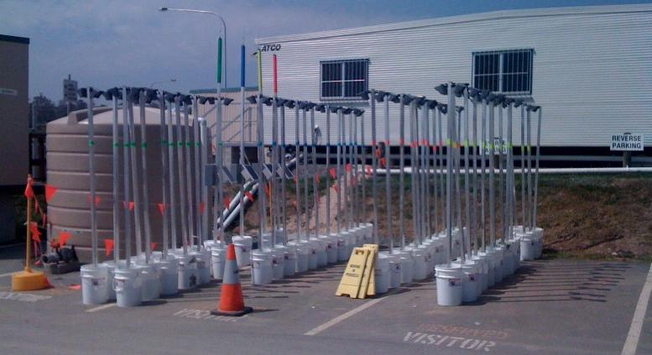
$30K savings every 2 weeks
Special Applications

Slide 17



Special Applications
Remote Infrastructure:
Thieves on ATVs sneaking into a remote FAA radar tower.
Cold Weather:
Protecting Rooftop in -20 F below zero.
Fenced Lots:
Secure assets stored behind fences and gates.

Slide 18
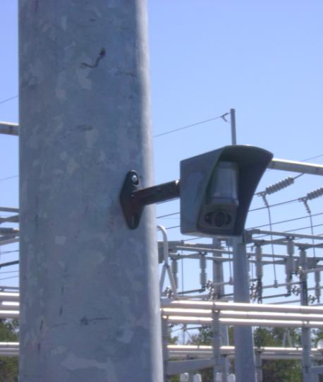
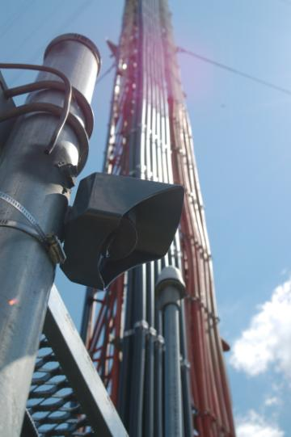
Special Applications

Slide 19

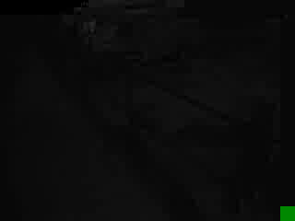
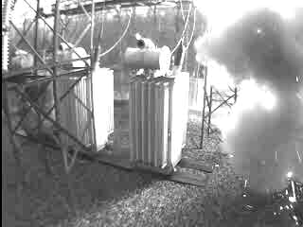
Special Applications
Substation:
No prosecution
Needed
Substation Arrest:
Theft of transformer grounding rods.
Infrastructure:
Winter Copper Theft
at utility storage yard

Slide 20


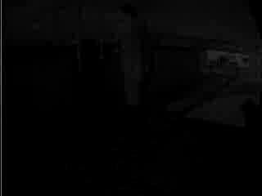
Special Applications
Rooftop HVAC Theft:
Thief climbs on roof and hauls up tools.
Thief Attacking Storage Container:
He would have more effective with a larger hammer. He was arrested.
Police Arrive:
Very little space to run on a rooftop.

Slide 21

Case Studies
Construction
  Remote Storage Lot
Oil Field

Slide 22
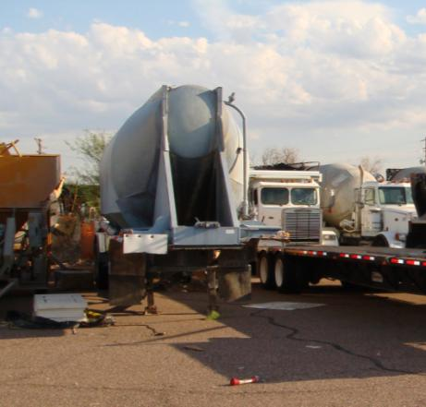
Construction
Special Applications
Storage site of large Heavy Construction Company in Arizona.
Target of continuous vandalism and theft.
$40K in losses
No budget for surveillance system.

Slide 23
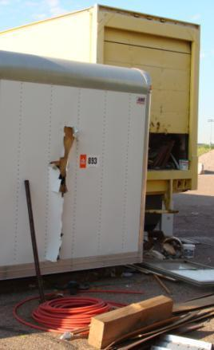
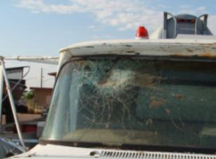
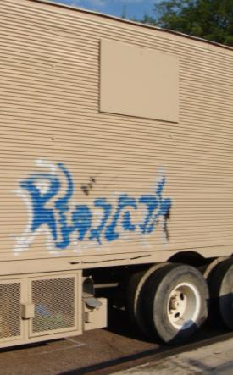
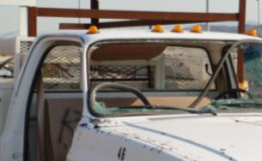
Construction - Vandalism
Special Applications

Slide 24
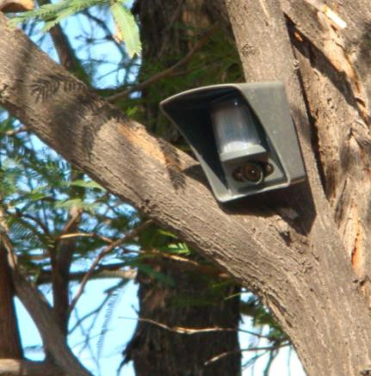
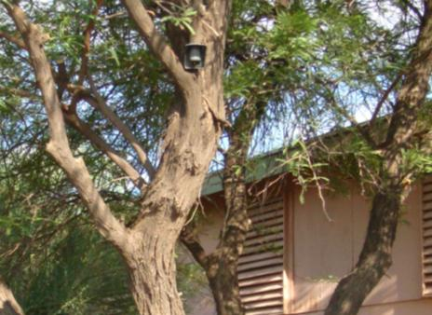
Construction – 3 MotionViewers
Special Applications
Mounted one in tree near vacant building.

Slide 25
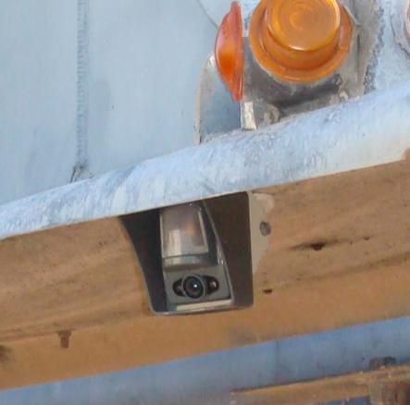
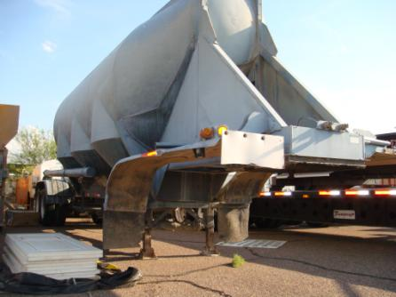
Construction – 3 MotionViewers
Special Applications
Mounted one under trailer.

Slide 26
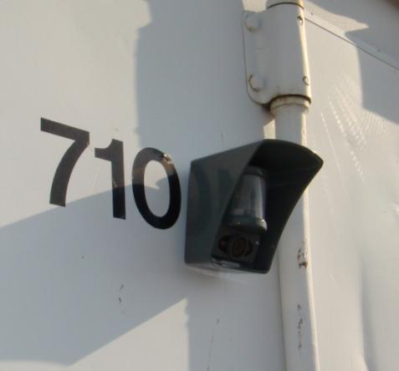
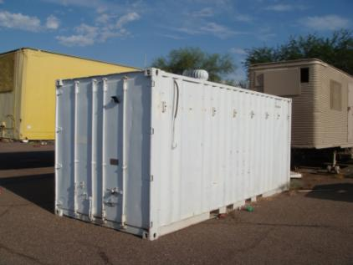
Construction – 3 MotionViewers
Special Applications
Mounted one on a container

Slide 27


Construction – Intrusions
Special Applications
Thieves with Ladder:
Band of youth on crime spree.
Teen Vandals:
Baseball bats and cell phone flashlights.
Daytime Intruder:
Selecting property to load on trailer.

Slide 28
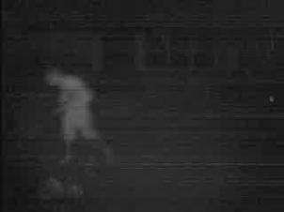
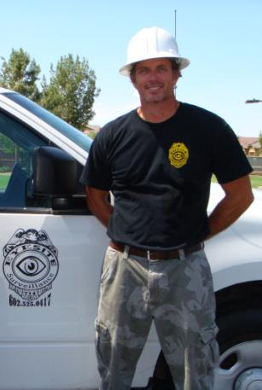
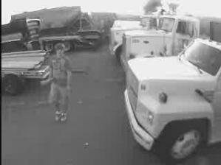
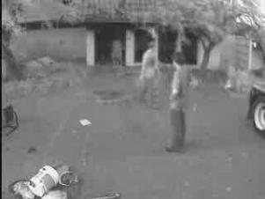
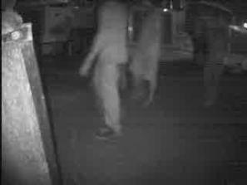
Construction – 40 arrests/4 Months
Special Applications

Slide 29
Case Studies
Special Applications
Construction
Oil Field
  Remote Maintenance Facility

Slide 30
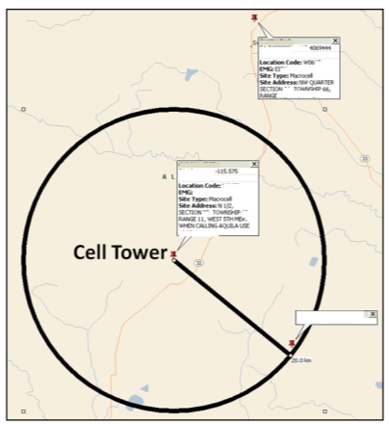
Remote Oil Patch - Location
Special Applications
Northern Alberta, Canada.
Maintenance/Storage Facility.
CCTV and DVRs worked but no police effort – because not real time.
Old video = no action

Slide 31
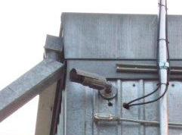
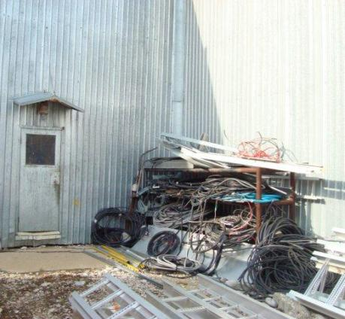
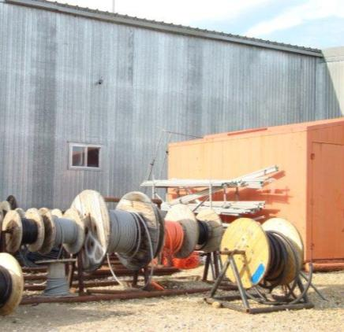
Remote Oil Patch - Facility
Special Applications
Existing Surveillance Camera

Slide 32
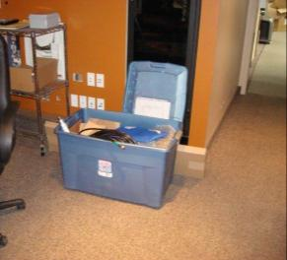
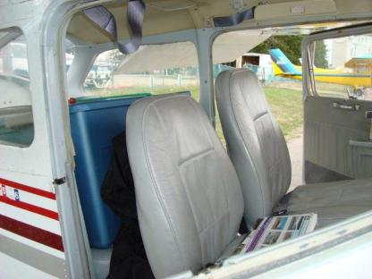
Remote Oil Patch - Preparation
Special Applications
Staged and tested system live in shop before leaving.
Loaded everything into small plane for transport to site.

Slide 33

Remote Oil Patch – Cell Antenna
Special Applications
Installed external Yagi antenna for extended cell range.
Signal strength went from 0 bars to 4/5 bars.

Slide 34


Remote Oil Patch - MotionViewers
Special Applications
Installed system with magnetic mounts.
Instant installation.

Slide 35

Remote Oil Patch - MotionViewers
Special Applications
Formerly impossible job became affordable and profitable.
Instant notification for police response.
Corrected CCTV deficiencies.

Slide 36
Click to Return to Applications

Slide 37
Blended Video Applications
Blended Video for Enhanced Surveillance
  Every new job
  Retrofit existing surveillance projects for enhanced performance
New Surveillance Architecture
  Combines wired CCTV cameras with Cordless/Wireless MotionViewer scouts
Scouts – Detect/Notify for immediate confirmation
  Present Video for Law Enforcement response
CCTV Cameras - High Quality Video/DVR
  Post Event Video for coordination, review and analysis

Slide 38
Blended Video Products
Outdoor
MotionViewer
PIR
Motion
Sensor
V6000 GPRS
Panel
Video Camera
Standard
Extended Temp

Slide 39




Blended Video Architecture
Blended
Video
Scouts + PTZ enabled 30% savings over standard architecture.
VS

Slide 40
Blended Video Architecture
Blended
Video
Providing “Response” and “Arrests” beyond traditional surveillance and DVRs
Combining Alarm Systems with CCTV
Customers want captures:
  Mitigate loss before it occurs
  Satisfaction beyond insurance claim
  Maximize deterrence

Slide 41

Traditional Surveillance Design/Quote
Blended Video Applications
System designed with wired CCTV cameras for both continuous recording and security needs. No RMR component for long-term revenue.
16 Channel DVR
12 wired Cameras
$28,000

Slide 42


Winning Bid – Blended Video
Blended Video Applications
System designed with wired CCTV cameras for continuous recording where needs mandated actual surveillance. Videofied MotionViewers used for security needs
8 Channel DVR
5 wired Cameras
7 MotionViewers
$21,000

Slide 43

Blended Video Case Studies
Vancouver Olympics
Remote Mine
40 Arrests in 4 Months
Detroit Public Schools

Slide 44



Vancouver Olympics
Blended
Video
MotionViewers on portable “bucket cams”
Perimeter
Choke Points
Assets
Moved as event evolved

Slide 45

Vancouver Olympics
Blended
Video
High Res PTZ:
Mast Mount
Command Post
Streaming

Slide 46


Intrusion/Arrest
Blended
Video
Alert from Scout
Bucket Cam at 2:30 AM
Once alerted Mobile Command Vehicle PTZ captured the subjects shaking gates.

Slide 47


Intrusion/Arrest
Blended
Video
View from Command Post PTZ

Slide 48

Intrusion
Blended
Video
Alert from Scout
Equipment there worth in the hundreds of thousands of dollars.
Response time was around 90 seconds. No damage or theft. Site remained operational.

Slide 49
Olympics – a Win!
Blended
Video
30% less cost
Increased Flexibility
Apprehensions
Redeploy as needed

Slide 50

Blended Video Case Studies
Vancouver Olympics
Remote Mine
Detroit Public Schools

Slide 51

Case Study:
Mothballed Mine
Blended
Video
Difficult Site:
150 Acres
No Power
No Lighting
Remote Location
Multiple Buildings

Slide 52



Mothballed Mine:
Traditional Options
Blended
Video
Security Officers
On-site Patrols
MSU
(Mobile Surveillance Units)
Attempted Both Options:
Budget allowed only 2 officers
Budget allowed only 3 MSUs

Slide 53
Budget-Limited Results:
Inadequate Coverage
Blended
Video
2 guards proved ineffective:
  Provided some deterrence
  One hour tours too long
  Losses continued
3 MSUs and full-time surveillance operators proved ineffective:
  Unable to view entire site
  Losses continued
After Sunday theft – “Do something NOW!”

Slide 54

Blended Video:
Adequate Coverage
Blended
Video
Blended Video installed on Monday
Installation:
Pre-programmed in shop and then mounted in field
Magnetic Mounts
Simple/Immediate

Slide 55

Panel/Communicator
Installation
Blended
Video
Panel placed in plastic weather-proof NEMA box and hid in a culvert.
-20F to +140F operating temp range.
Centrally located at site for up to 24 MotionViewers.
Internal cell modem.
Cordless - No AC power
Up to 4 year battery life.

Slide 56


Adequate Coverage:
MotionViewer Installation
Blended
Video
Front Gate & Doorways

Slide 57


Adequate Coverage:
Entries/Choke Points
Blended
Video

Slide 58

Adequate Coverage:
Fence Line
Blended
Video

Slide 59

MSU centrally located “eye in the sky”
Blended
Video

Slide 60

Mothballed Mine:
Intrusion
Blended
Video
People present in initial video alarm delivered to Central Station.
Owner was alerted.

Slide 61



Mothballed Mine:
Response
Blended
Video
End User logged into MSUs and tracked thieves
Law Enforcement notified and surrounded site
Intruders captured red-handed as they left the site.

Slide 62

Mothballed Mine:
Apprehension
Blended
Video
First capture in over 10 years of trying.
Nationwide deployment with End User to protect outdoor assets.
Arrest publicized in community to increase deterrence.
Suspect plead guilty and is awaiting sentencing.

Slide 63

Blended Video Case Studies
Vancouver Olympics
Remote Mine
Detroit Public Schools

Slide 64
DPS Case Study
Background
Blended
Video
Closed 30 buildings - required security
Issued RFP for 30 school buildings
  Required immediate installation
D/A Central of Security-Net chosen
  2 teams of 2 spent 6 days to install 30 schools
  Pre-programmed and tested at their shop

Slide 65
Ken Kirschenbaum Newsletter
Blended
Video
Ken
We are a Videofied dealer and our customers have had tremendous success with the product. The largest school system in the Detroit area closed 30 school buildings and immediately put in Videofied to protect the empty buildings. To make the story interesting, the buildings are without power and heat. The target is copper usually and the damage that could be done to get the copper is enormous.
The challenge was to protect 30 buildings, each over 100,000 square feet, for less than $100,000 in less than 2 weeks. We did it! In the recent past it took a month and over $150,000 to install one school with conventional alarm and CCTV systems.
The good news is twofold: both the school police and local police know that when one of these alarms is forwarded to dispatch that it is for real, the perps can be described, and they give it a high priority response, usually arriving at the scene with 10 minutes; secondly, the district has recorded over 60 arrests in 6 weeks, starting the first day of operation with 3. Activity level is down now that word is out on the street but arrests continue weekly. We are now getting kids sneaking in during daylight hours to do mischief or play basketball. One recent event was kids riding their bikes in the hallways. You can well imagine the stuff that could come down if a kid got hurt.
Thanks for your comments on this,
P. David Shelton, President
D/A CENTRAL, INC.

Slide 66

Detroit School Bldg.
Blended
Video

Slide 67

Installation Crew
Blended
Video

Slide 68

Pre-programmed System
Blended
Video

Slide 69

Mounting Cordless Panel
Blended
Video

Slide 70

Mounting Cordless MotionViewer
Blended
Video

Slide 71


45 Arrests in 4 weeks
Blended
Video
Apprehended
Vandals with
Sledge Hammers:
Youths intent on inflicting serious damage to the school building.
Copper Theft:
Thieves attacked plumbing and electrical infrastructure.

Slide 72
DPS Case Study Results
Blended
Video
45 apprehensions in 4 weeks
No false alarms
Police support/expedited response
$100s of thousands saved in damages
> $1 million saved in reduced boarding costs
Mitigate liability due to injuries

Slide 73
Click to Return to Applications

Slide 74
Mainstream Applications
Cell Upgrade with Video Included
  Existing commercial systems
  Existing residential systems
Small commercial and Residential
  2-way voice and video
  Cell and Monitoring bundled into one monthly price.

Slide 75


Mainstream Products
XL 601 Kit
Panel
1 MotionViewer
2 Contacts
2 Prox Tags
XL 621 Kit
Panel
2 MotionViewers
2 Prox Tags

Slide 76


Mainstream Products
XT Panel
Upgrade
Takeover
XT 601 Kit
Panel
1 MotionViewer

Slide 77
Peripherals/Accessories
Smoke
Contact
Exterior
Prox Arming
Remote
Arming
Exterior
Siren/Strobe
Interior
Siren
Keypad

Slide 78


Mainstream Products
Residential Burglar:
Police dispatched to a crime-in-progress.
Residential Burglar:
MotionViewers have true night vision and operate in total darkness.
Residential Burglar:
Police already know that there are two thieves burglarizing this home.

Slide 79
Does it work?
This sequence of videos documents the arrest of a serial burglar.
This thief had been preying on homes and small businesses in Chicago.
The owner of a small business installed Videofied.
Police gave priority response to the dispatch of a crime-in-progress.

Slide 80

Initial Intrusion
Mainstream

Slide 81

Mainstream
Exploring the Premises

Slide 82

Law Enforcement Responds
Mainstream

Slide 83

K-9 Team Arrives
Mainstream

Slide 84

Arrested
Mainstream

Slide 85

To the Squad Car
Mainstream

Slide 86
Click to Return to Applications

